Slide 1
Supply Chain Analytics – Make vs Buy
Tenant Industries – by Aditya Verma
Role - Business Analyst/ Data Analyst

Slide 2
Introduction
The case study focuses on a make-versus-buy decision. I as a Supply Chain Analyst at a fictitious company called Tenate Industries, which sells replacement parts for industrial pizza ovens.
Motive: To calculate the total cost for both the Make and Buy options
About
Tenant Industries sells replacement parts for industrial pizza ovens
The company receives multiple supplier quotes per part
Management needs a data-backed Make vs Buy decision
In supply chain, choosing the lowest unit cost is misleading. The real decision must be based on full cost, volume sensitivity, and internal capacity.

Slide 3
Agenda of the meeting
This project focuses on solving a real-world supply chain problem — deciding whether to manufacture internally or buy from suppliers, using cost-driven analysis and scenario planning.
Objectives
Compare supplier costs using Extended Cost & Full Cost
Identify the lowest-cost supplier at different volumes
Perform scenario analysis for changing demand
Evaluate internal manufacturing feasibility
Recommend Make or Buy decision

Slide 4
Key Metrics
Metric | Meaning
Unit Cost | Cost per unit
Extended Cost | Unit Cost × Volume
Non-Recurring Expense | One-time setup/tooling cost
Full Cost | Extended Cost + NRE
**A supplier may have a low unit cost but a high non-recurring expense — which completely changes the decision at lower volumes**

Slide 5
Supplier Selection
Analyzing the Non- Recurring Expense and Extended Cost of the supplier offering the lowest quoted amount through a comparative analysis of all received quotations.
Creation of Full Cost and Extended Cost Measure.
Formulas
Extended Cost: Unit Cost * Volume
Full Cost: Non-Recurring Expense + Extended Cost

Slide 6
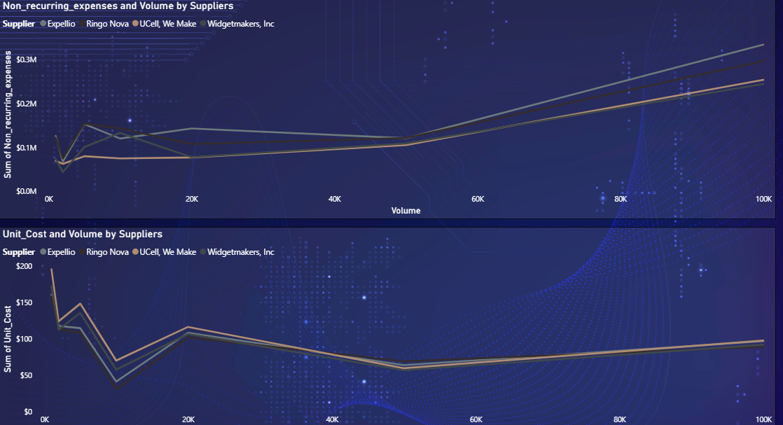
Visualizing Unit Cost and Non - Recurring Expenses from each supplier.
Non-Reccuring-Expense:
NRE increases with volume: Setup, tooling, and capacity costs rise from ~$50K–80K at 1,000 units to ~$250K–300K beyond 50,000 units.
Low-volume impact: At 1,000–5,000 units, NRE can account for 30–45% of total cost, strongly influencing supplier selection.
High-volume impact: At 50,000+ units, NRE adds $5–6 per unit, making it a major cost driver, not negligible.
Unit Cost:
Economies of scale: Unit cost drops from ~$120–150 at 1,000 units to ~$65–75 by 20,000 units (≈ 50% reduction).
Beyond ~50,000 units: Unit cost rises to ~$85–95 due to capacity strain and overtime.
Non-recurring expenses: Increase from ~$110K to $250K–300K at higher volumes.
Key insight: Even a $5/unit advantage can be offset by higher NRE → lowest unit cost ≠ lowest total cost.

Slide 7
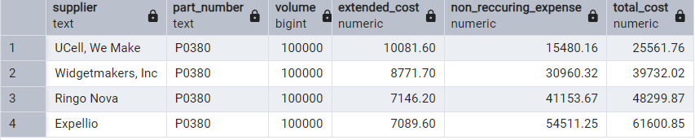
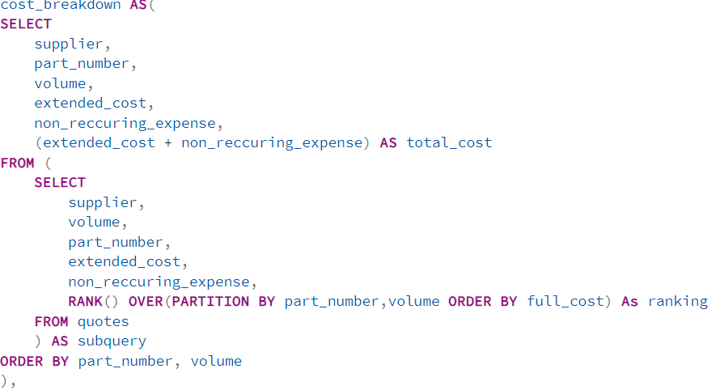
Full Cost Analysis
**Finding the Full Cost of the Suppliers for the part number P0380 at Volume 1,00,000. ➔
Why Lowest Unit Cost ≠ Lowest Total Cost?
While unit cost drops by over 50% during early scaling, non-recurring and marginal costs rise sharply beyond 50,000 units, making Full-Cost evaluation critical for supplier selection.
Example at 50,000 units:
Cost Type | Amount
Unit Cost | $70 * 50,000 = $3.5M
Non-Recuring Expenses | $250K
Full Cost | $3.75M

Slide 8
Scenario Analysis
Problem Statement:
Identifying the lowest-cost supplier for a given demand scenario when supplier pricing varies by volume and includes both unit and non-recurring costs.
Formulas used:
  Created an scenario Volume Slab with 500 Unit Gap from 1000 – 1,00,000.
  Buy - Scenario Full Cost = IF(HASONEVALUE(Quotes[Supplier]), MINX(FILTER(Quotes, 'Scenario Volume'[Scenario Volume Value] >= Quotes[Volume] ), Quotes[Non_recurring_expenses] + DIVIDE(Quotes[Unit_Cost] * 'Scenario Volume'[Scenario Volume Value], [Yield Rate])), BLANK()).
  Calculates the total buy cost for a specific supplier at the selected scenario volume, accounting for unit cost, non-recurring expenses, and yield.
  Buy - Full Cost(All) = MINX(FILTER(Quotes, Quotes[Volume] <= MIN('Scenario Table(All)'[Scenario Volume])), MIN('Scenario Table(All)'[Scenario Volume]) * Quotes[Unit_Cost] + Quotes[Non_recurring_expenses]).
  Evaluates the total buy cost across all suppliers at the selected scenario volume and returns the minimum full cost, enabling optimal supplier selection.

Slide 9
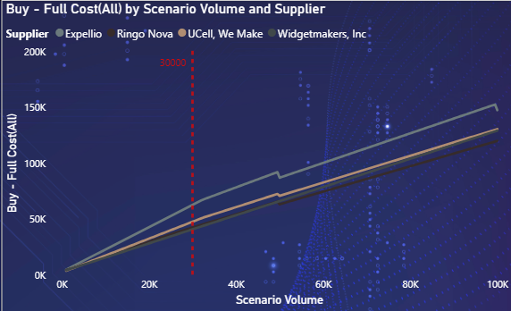
Interpretation:
Low Volume (<= 10,000)
Cost differences are driven mainly by Non-Recurring Expenses (NRE).
Suppliers with lower setup/tooling costs appear more competitive, even if their unit cost is higher.
Mid Volume(~20,000 – 40,000)
Unit cost begins to dominate total cost.
Supplier cost curves start to converge, and small unit-cost differences create large total-cost impacts.
High Volume(>= 50,000)
Full cost rises sharply for all suppliers.
This reflects capacity constraints, overtime labor, and incremental setup costs.
Cost separation increases again, indicating that supplier scalability differs at high demand.
Formula Used:
Buy - Full Cost(All) = MINX(FILTER(Quotes, Quotes[Volume] <= MIN('Scenario Table(All)'[Scenario Volume])), MIN('Scenario Table(All)'[Scenario Volume]) * Quotes[Unit_Cost] + Quotes[Non_Recurring_Expenses]).
Why This Chart?
This model dynamically selects the lowest full-cost supplier for any demand scenario by correctly aligning scenario volume with supplier quote slabs.

Slide 10
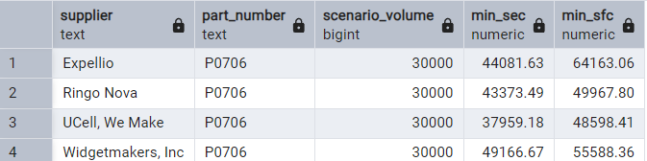
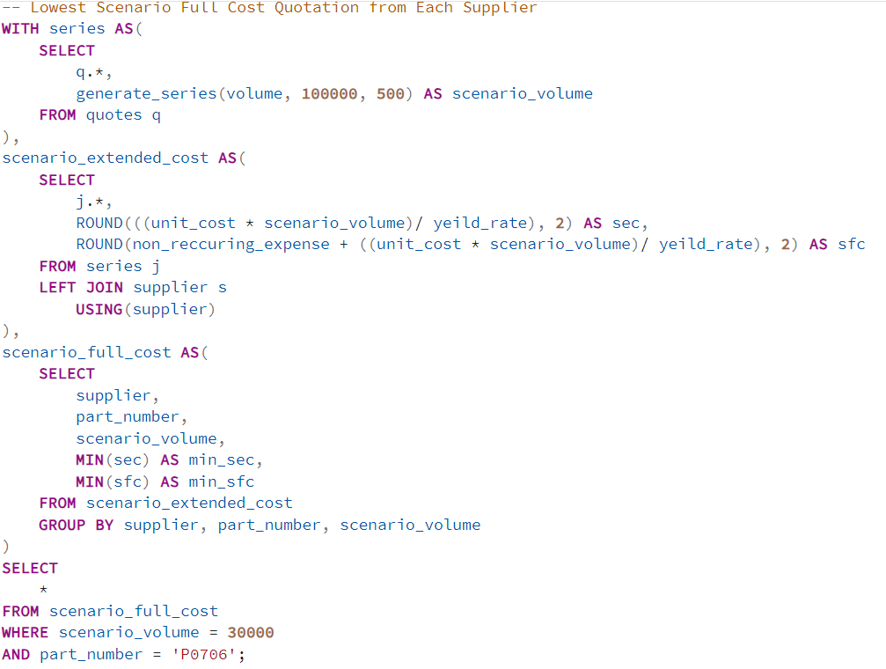
Full Cost Analysis
Why Full Cost?
To calculate realistic Buy cost at any demand level. (Supplier quotes are given at fixed volume slabs, but demand is dynamic).
To correctly handle yield rate (real-world constraint)
To ensure only one supplier is evaluated at a time.
To select the best applicable quote for that supplier.
Formula Used:
Buy - Scenario Full Cost = IF(HASONEVALUE(Quotes[Supplier]), MINX(FILTER(Quotes, 'Scenario Volume'[Scenario Volume Value] >= Quotes[Volume] ), Quotes[Non_Recurring_Expenses] + DIVIDE(Quotes[Unit_Cost] * 'Scenario Volume'[Scenario Volume Value], [Yield Rate])), BLANK()).

Slide 11
Full Cost Vs Full Cost(All)
Aspect | Buy Cost | Buy Cost (All)
Scope | Single supplier (row-level) | All suppliers (global comparison)
Supplier Context | Evaluated per supplier | Evaluated across all suppliers
Purpose | Calculate realistic buy cost for a selected supplier | Identify the lowest buy cost among all suppliers
Volume Handling | Uses scenario volume aligned to supplier quote slabs | Uses scenario volume and evaluates all eligible quotes
Yield Rate Adjustment | ✅ Included | ❌ Not included (baseline comparison)
Non-Recurring Expense (NRE) | ✅ Included | ✅ Included
Output Type | Supplier-level cost | Minimum cost value
Used In | Supplier-wise visuals, tables | KPI cards, “Lowest Cost Supplier” indicators

Slide 12
Make Vs Buy Analysis
Make vs Buy analysis compares the full internal manufacturing cost against the lowest external procurement cost to determine the most cost-effective sourcing decision.
Formulas
  Additional Unit Capacity Required = MINX(Internal_Mfg_Resource_Estimates, MAX('Scenario Volume'[Scenario Volume Value] - Internal_Mfg_Resource_Estimates[Existing_Capacity], 0)).
  Capital Investment Required(Make) = MINX(Internal_Mfg_Resource_Estimates,Internal_Mfg_Resource_Estimates[Machine_Fixed_Cost] * ROUNDUP(DIVIDE([Additional Unit Capacity Required], MIN(Internal_Mfg_Resource_Estimates[Unit_Capacity])), 0)).
  Cost Avoidance = IF(HASONEVALUE(Product_Dimension[Part_Name]), ABS([Make Scenario(Full Cost)] - [Buy - Scenario Full Cost]), BLANK()).
  Make Scenario(Full Cost) = MINX(Internal_Mfg_Resource_Estimates, [Capital Investment Required(Make)] + (Internal_Mfg_Resource_Estimates[Cost_per_Unit] * 'Scenario Volume'[Scenario Volume Value])).
  Make Vs Buy = IF(HASONEVALUE(Product_Dimension[Part_Name]), SWITCH(TRUE(), ABS([Make Scenario(Full Cost)] - [Buy - Scenario Full Cost]) = 0 , BLANK(), [Make Scenario(Full Cost)] - [Buy - Scenario Full Cost] > 0, "Buy", "Make"), BLANK()).

Slide 13
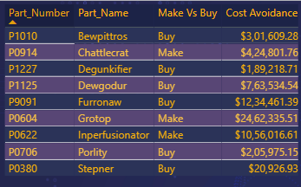
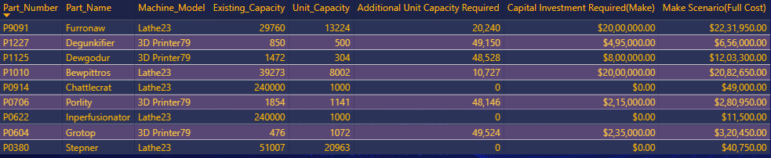
Buy Vs Make Decision Making
**This is a Visual for the supplier Ringo Nova at Volume 50,000 Units.
Q. Why This Chart? ➔
A Make vs Buy recommendation for each part along with the Cost Avoidance achieved by choosing the cheaper option.
Make recommended for 3 parts, generating ~$1.73M in total cost savings.
Buy recommended for 6 parts, delivering ~$3.51M in total cost savings.
**67% of parts are cheaper to Buy, while 33% are cheaper to Make, showing that Make vs Buy decisions must be evaluated part-by-part.
Q. Why This Chart? ➔
Internal manufacturing feasibility per part.
Capacity constraints and capital investment required.
Final Make Scenario Full Cost.
Conclusion:
Parts requiring >$2M capex are consistently recommended as Buy. Whereas, Zero-capex parts are consistently recommended as Make.

Slide 14
Summary
Evaluated 9 critical replacement parts using a scenario-based full-cost model that integrates supplier pricing, non-recurring expenses, yield impact, and internal capacity constraints.
Demonstrated that unit cost is not a reliable decision metric: while unit cost improves by ~50% at scale, non-recurring and capacity-driven costs increase to $250K–$300K, materially impacting total cost.
Applied dynamic demand scenarios (1K–50K+ units) to identify the lowest full-cost option across suppliers and internal manufacturing alternatives.
Decision outcomes:
1. Make recommended for 3 parts, delivering ~$1.73M in savings, enabled by sufficient existing capacity and zero incremental capex.
2. Buy recommended for 6 parts, unlocking ~$3.51M in savings, driven by prohibitive internal capital investment requirements (> $2M).
Strategic insight: Internal capacity availability is the primary determinant of Make decisions; when capacity expansion is required, Buy consistently outperforms Make on a full-cost basis.

Slide 15
Thank You.
Presentation by Aditya Verma
~Aspiring Business/Data Analyst

